Slide 1
QUESTIONS & ANSWERS ABOUT THE VIRTUAL DATA WAREHOUSE
Roy Pardee
Group Health Research Institute
HMORN VOC Co-Lead
An introduction for New HMORN site staff
Notes:
Hello and welcome to the HMORN! My name is Roy Pardee and I’m one of the co-leaders of the VDW operations committee. This presentation is intended to orient you to the HMORN’s virtual data warehouse, both as potential users and as implementers.
I’m going to cover what the VDW is & isn’t, show how it’s used, what data is in it, how best to use it, and how its governed. I’m also going to say just a tiny bit about what you need to implement.

Slide 2
Meta
Agenda
What VDW Is/Isn’t
Brief Hx
Use Overview + Benefits
Survey Existing Implementations
Documentation & Reference
Common pitfalls
Governance & Communications
Discussion/Q&A
Feel free to interrupt with questions.
Notes:
Time is tight, but here’s what I hope to get through today.

Slide 3
The VDW is…
a series of dataset standards and automated processes in place at each of 15 HMORN sites,
that allow SAS programs written at one HMORN Site to be run against all the others
quickly, and
with a minimum of site-specific customization.
Notes:
Note that the program travels to where the data are—at the sites. There is no central store of data anywhere. Every site retains complete control over its data.
It is ‘virtual’ in the sense that there is no centrally located store of data against which data from all sites can be touched in a single run. It might also be called a federated or distributed data warehouse.

Slide 4
It is Not…
A centralized database.
No secret bunker where you can get at all the data at once.
Data stay at the originating sites.
A means for fully automating data-based research.
VDW is very human-mediated.
A replacement for the local data you already know & love.
Notes:
Getting VDW data out of a site requires that an actual human being who has access to VDW data at that site run your program and turn the resulting data over.
Early on at least this was a strength of the VDW—it made the idea at least moderately palatable to researchers and IRB administrators, who tend to be very sensitive about the possibility of exploitation/misuse. Early on slides like this were absolutely necessary to avoid being shouted down as irresponsible or data thieves.
Nowadays, we have seen enough routine requests of the same form go through repeatedly that we have wished there were a more automated process for answering questions with the VDW, and in fact several partial solutions are in existence today, which build on top of the VDW. Probably the most functional is the various incarnations of the DRN Distributed Query Tool (aka PopMedNet, aka Mini-Sentinel query tool) out of Jeff Brown’s shop. The other major contender is SHRINE atop i2b2 (also out of Harvard).

Slide 5
Brief History
Pre-2002: No VDW. Collaborative studies had each site doing its own custom programming.
At project end—toss the data (!)
Expensive & Inefficient
2002: Cancer Research Network uses infrastructure $ to
develop standardized dataset specifications,
fund the effort of reshaping local data into these standard specifications.
Notes:
The specs borrowed heavily from two other data consortia in place at the time: the Center for Research in Therapeutics (CERT), and the Vaccine Safety Datalink (VSD).

Slide 6
Brief History (cont)
2009: Seeing its benefits & general applicability, HMORN took on governance of the VDW.
Site VDW activities funded variously by project infrastructure + Indirect $.
HMORN VDW Operations Committee (VOC) formed to manage & coordinate:
Specifications
Documentation
QA Work
Notes:
It was Jeff Brown of Harvard who took the initiative to bring VDW over to HMORN, thereby “breaking it out of the cancer ghetto.” Jeff led the VOC for the first two years of its existence.

Slide 7
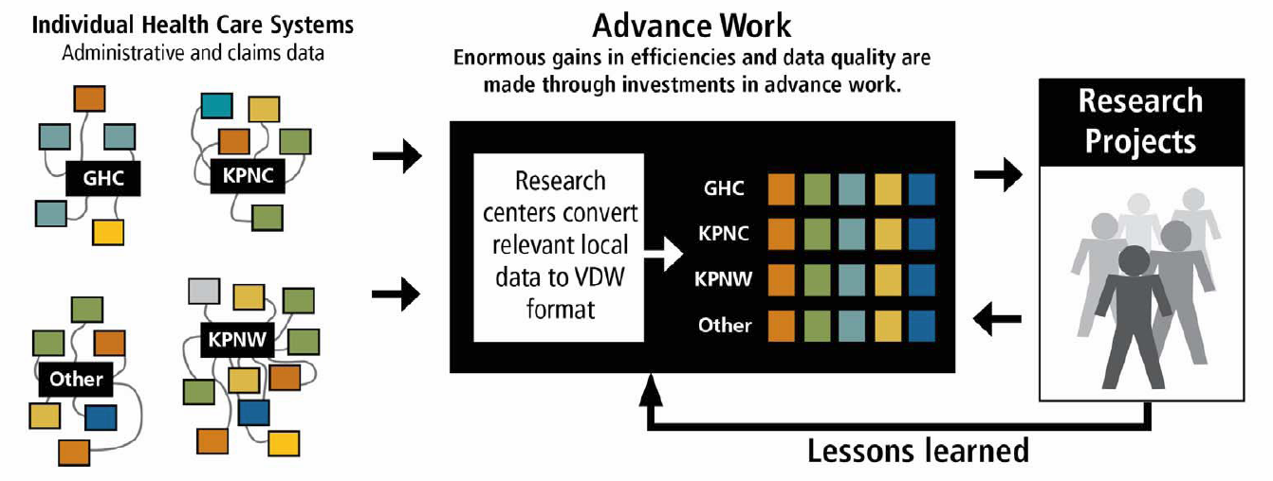
How does it work?
Notes:
VOC puts together dataset specifications, guidelines, etc. that describe the VDW datasets and give guidance in how to implement them.
Local sites take their indigenous data and reshape/merge it into files that meet those specifications. (This is the most difficult & time-consuming part.)
Projects needing multi-site data will typically:
Have a programmer write a data extraction against her local VDW files (or if at a non-VDW site, against the bare specifications).
Distribute the resulting program to each participating site, typically by posting it & an associated workplan to the CRN portal.
Site staff (who are normally budgeted on the project) download & run the program, examine the output and
by some appropriate means transfer the resulting data and output to the lead site,
Where it is merged and analyzed, manuscripts are written, etc.

Slide 8
What are the benefits?
Eases collaborative data-based research.
Standard macros & utility code.
Depending on your existing assets, could be your first unified research data warehouse: one-stop shopping.
Data vetted through repeated use & the bug reporting/remediation process.
At its best, VDW is a vehicle for preserving & cumulating the benefits / fruits of project-specific work.
Notes:
Since VDW code can be re-used not just over time at a single site, but also across sites, it gives an unprecedented economy of scale on programming effort. Thus we can spend more time refining, testing and improving utility code.
Similarly, because the same underlying data is used by multiple studies over time, defects are much more likely to come to light and be fixed, to the benefit of any subsequent studies. Compare, the earlier practice of putting together study specific datasets and then simply discarding them when the analyses were complete.
At sites like GHC and KPNW, the VDW is a source of first resort for pretty much all projects, whether multi-site or local only, simply because of the ease of use.

Slide 9
How Much Data Is There?
15 HMORN sites have implemented one or more VDW datasets.
Currently 8 data areas, comprising 15 datasets.
Tumor
Utilization (encounters)
Enrollment/Demographics
Rx Fills
Lab Results
Vital Signs
Census
Death
Coming Soon:
Infusion (chemo)
Orders
Dental

Slide 10
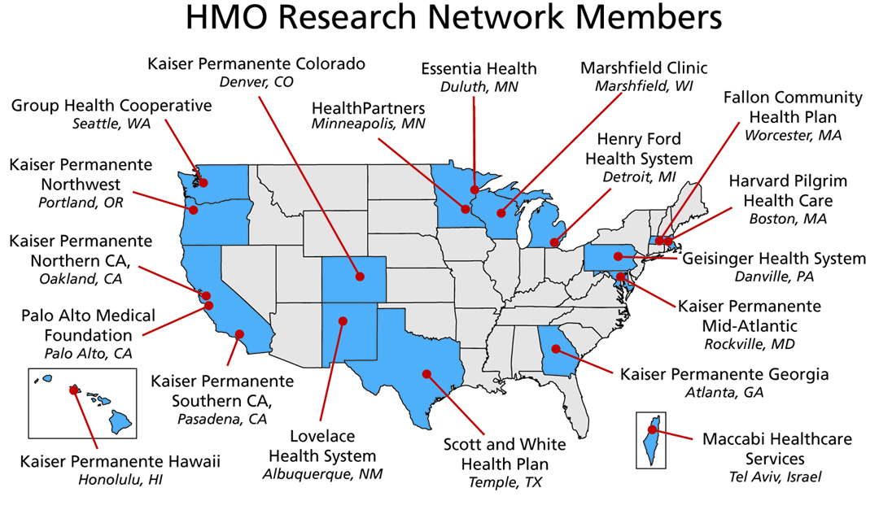
HMORN Sites
Notes:
Of these, I think only Maccabi & PAMF has not yet formally implemented one or more VDW datasets (I believe they are working on some VDW datasets for a particular project—not sure what the status of that effort is at this writing.)

Slide 11
VDW Data Areas

Slide 12
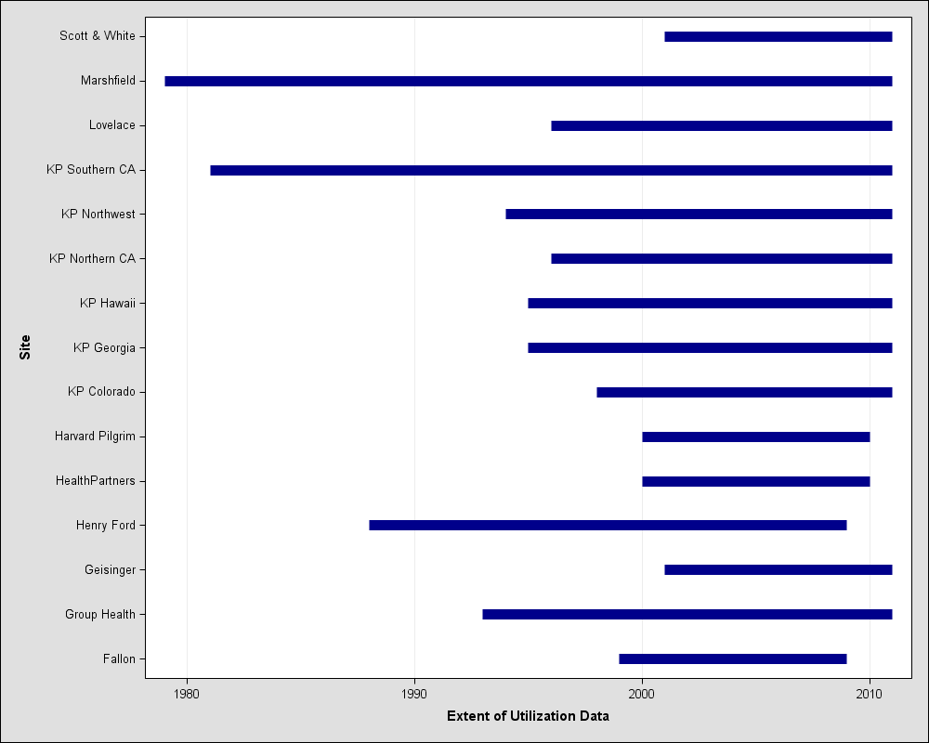
Over what span of time?
Notes:
This is just the utilization file, but it gives you a sense for how far back we go. Other files have greater or lesser extents in time.
Note that we’re well in front of the advent of the modern integrated EMR system here. Other files (e.g., Vital Signs) have pretty much only been possible to do from EMR data, and so those don’t go back as far as these.

Slide 13
What types of people/data?
Only HMO members? NO.
Only Insured people? NO.
Only (modern integrated) EMR data? NO.
In general, we use data from all compatible sources, including:
Legacy (pre-modern EMR) internal systems
Claims (rx, facility, professional)
EMR
Notes:
While it’s true that most HMORN research projects require marshalling a cohort of data on whom we believe we have complete data capture (e.g., “members”—those insured by our orgs) there are projects that don’t require this. In order to enable the widest range of research, we put basically all available data into the VDW—patients as well as members.
The general philosophy is to put everything in, and include data that will allow projects to throw out what they don’t want. So projects that do need complete-capture-cohorts would e.g., use the Enrollment table to identify people/periods for whom we expect something like complete capture.

Slide 14
Group Health VDW Data Sources Gene Hart, Roy Pardee, Tyler Ross
L
E
G
A
C
Y
V
D
W
N=2.9M
N=54K
N=116M
N=145K
N=6.5M
N=5M
N=554K
N=56M
N=77K
N=85M
N=331K
N=87M
Notes:
This is a poster we did for the 2007 Annual Meeting. You can see it (and some other sites’) in detail here:
https://appliedresearch.cancer.gov/crnportal/crn-committees-and-cores/sdrc/vdw-posters-presented-at-hmorn-2007
This should give a sense of the work involved in implementing these datasets. GH is not the most complicated of the VDW implementers, and our picture has changed considerably since 2007 (both simpler, and more complicated).

Slide 15
Where is VDW Documented?
Primarily On the CRN Portal
Implementation Overview
Dataset Specifications (left column)
Site implementation pages (cells)
Site Data Managers folder
list of
File Implementation guidelines
Programmer’s Guide
Issue Tracker
Notes:
Being something of a virtual organization, having a website be the primary point of engagement w/one another is pretty much the only choice.
Because CRN’s site is so functional, and because NCI was agreeable to keeping the VDW material there post-HMORN-takeover & opening up membership on the site to non-CRN staff, we have kept VDW material on that site. There is periodically talk of beefing up the HMORN’s web presence to a point where it could serve as the source of VDW documentation, but those efforts have not yet borne fruit.

Slide 16
Additional Material of Interest
HMORN.org’s Collaboration Toolkit has a wealth of information, including some great presentations:
Getting Your Questions Answered with the VDW
Using the VDW
VDW Tutorial for Programmers
Note:
CRN Portal requires a login, which requires affiliation w/an HMORN member organization.
HMORN.org is entirely open to the public.

Slide 17
Using the VDW
Whose permission do I need?
People at the Sites whose data you want.
Typically you find Investigators at the sites to collaborate or sponsor your project.
Those people navigate whatever IRB/Compliance requirements are in place locally.
Who can write a VDW program?
Any reasonably skilled SAS programmer with access to
The dataset specifications,
(preferably) a set of local VDW files, and
the programmer’s guide.
There is no central programming service or authority.

Slide 18
Using (cont)
Who will run my program?
Again, people at the sites whose data you want.
Take-home: budget for some site staff.
Some large projects/networks have something like a blanket IRB approval for more trivial requests (counts for feasiblility) and standing staff to run things.

Slide 19
Common Pitfalls Using VDW
Biggest is assuming that all HMORN sites are like yours.
Utilization comes completely from claims, or from non-claims.
We only treat people we insure.
Vast majority of inpatient stays are at external hospitals.
We have our own Tumor registry.

Slide 20
More Pitfalls
More “like me” assumptions:
We run the EPIC EMR, and have the Clarity reporting system.
Chemo data winds up in Procedures data, not Pharmacy.
Assuming all variables will be populated over all time (e.g., Race in Demographics is patchy).
Assuming uniformity of data across sites.
VDW does some cleaning/normalization, but not as much as most people assume.

Slide 21
Still more pitfalls
Assuming <<some data element you need>> is available in VDW.
Study the specifications!
In general:
Go slow.
Explore.
Take nothing for granted.
Don’t hesitate to consult with Dan & Roy.

Slide 22
What do I need to implement VDW here?
Programmers: intermediate-or-better in SAS or other ETL tools.
SAS Software
Required: BASE and STAT, possibly ACCESS (if RDBMS back-end).
Recommended: CONNECT, GRAPH
Some sites use an RDBMS (e.g. Oracle, MS SQL Server) for actual data storage—not required.
Hardware
Needs here vary wildly—happy to consult.

Slide 23
How is VDW Governed?
The VDW Operations Committee (VOC) is a consortium of selected Investigators and Programmers from various Research Networks (CRN, CESR, etc.).
Charged with maintaining and setting priorities for the VDW in consultation with HMORN Asset Stewardship.
Two co-leads: Dan Ng (KPNC) and Roy Pardee (Group Health) & one Administrative Coordinator: Sarah McDonald (Group Health).
One Workgroup per data area (almost) each of which has one Investigator lead and one Technical lead.
The VDW Implementation Group (VIG) is the set of Site Data Managers and interested programmers from all sites.
A support group for implementers.
Charged with vetting technical/data issues, including especially the feasibility of proposed spec changes.
Notes:
The VOC workgroups are formed more around interest than anything else, and don’t normally have representation from all VDW sites. Because of this lack of representation, the VIG acts as a backstop on the WGs, to make sure that e.g., an all-clarity-site workgroup doesn’t put a spec forth that would unnecessarily exclude non-clarity sites from implementing.

Slide 24
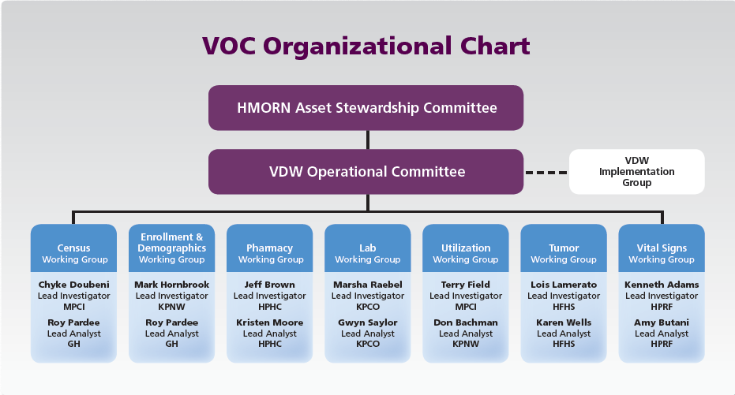
How is VDW Governed?
Notes:
The names are out of date here, but the structure is well depicted. The VOC consists of Investigator & Analyst representatives from the major research networks: CRN, CESR & Mini-Sentinel.

Slide 25
How is the VDW governed?
The VOC Workgroups
Steward their specifications
Correct any errors
Clarify anything unclear
Take suggestions for spec improvements & periodically submit to VIG for ratification for spec revision.
Consult with implementers.
Generate QA programs and periodically synthesize & report results.
Where there is interest, new working groups can be chartered.

Slide 26
Communications
Conference Calls
VIG Conference Calls: Fourth Tuesdays @ 12:00-1:00 pm Pacific Time.
Workgroups: various—documented on CRN Portal on this page.
E-Mail Lists
One for VDW Users.
One for VIG.
One per Workgroup.
Subscribe to any or all on this page.
We need you!
Nearly all of this is volunteer effort.
Please consider joining one or more Workgroups.

Slide 27
Thank You!
pardee.r@ghc.org

